Slide 1

How Open Source
Changes The Way We Work
Thank you for being here.
https://xoap.io
© 2022 xoap.io all rights reserved

Slide 2

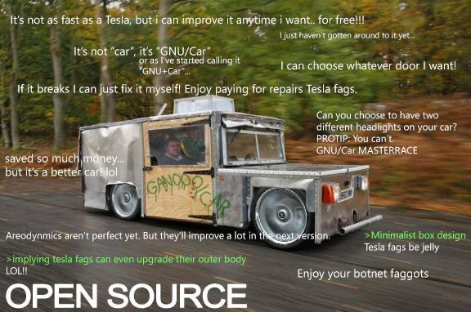
Open Source
It´s free
It´s adjustable, so I can create FRs for it
There are so many great projects out there
No proprietary black-boxes any more
The sky is not the limit
REALLY!?!
Thank you for being here.
https://xoap.io
© 2022 xoap.io all rights reserved

Slide 3
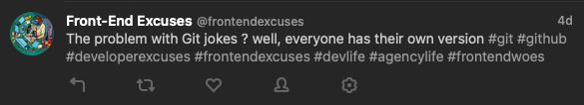
Thank you for being here.
https://xoap.io
© 2022 xoap.io all rights reserved

Slide 4




Your awesome infrastructure
Small GitHub Project …
being maintained by one individual
in the Australian outback
Thank you for being here.
https://xoap.io
© 2022 xoap.io all rights reserved

Slide 5

In chaos theory, the butterfly effect is the sensitive dependence on initial conditions in which a small change in one state of a deterministic nonlinear system can result in large differences in a later state.
Thank you for being here.
https://xoap.io
© 2022 xoap.io all rights reserved

Slide 6

Jaeger
Notes:
What do all these things have in common?

Slide 7

Envoy

Slide 8

Prometheus

Slide 9

Thanos

Slide 10
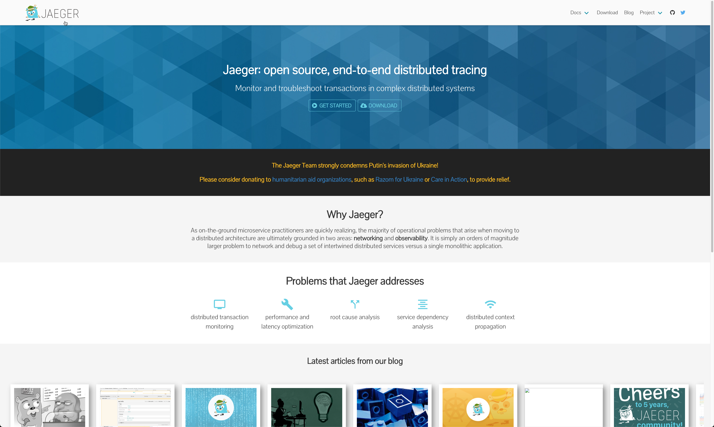
Thank you for being here.
https://xoap.io
© 2022 xoap.io all rights reserved

Slide 11
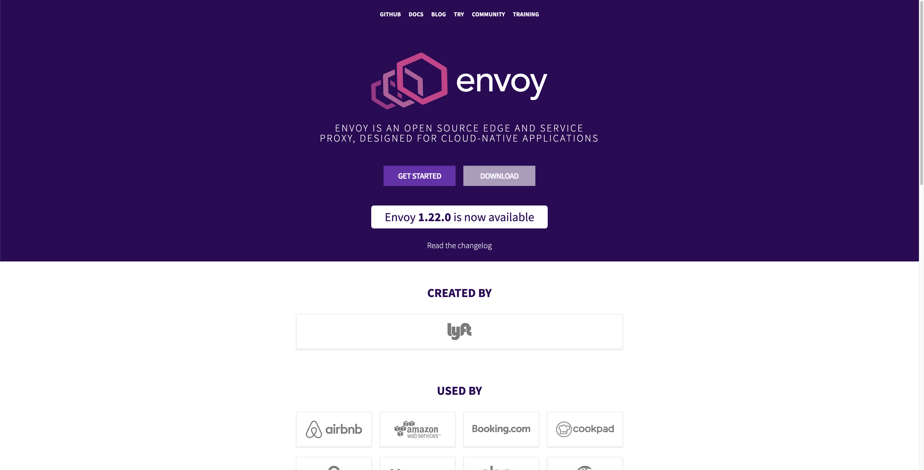
Thank you for being here.
https://xoap.io
© 2022 xoap.io all rights reserved

Slide 12
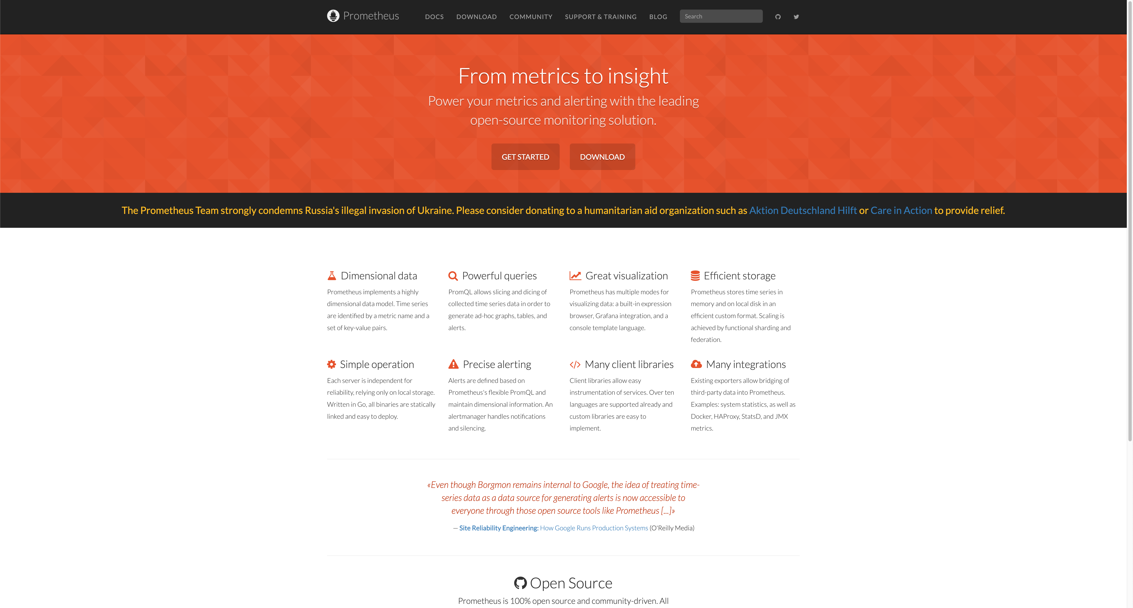
Thank you for being here.
https://xoap.io
© 2022 xoap.io all rights reserved

Slide 13
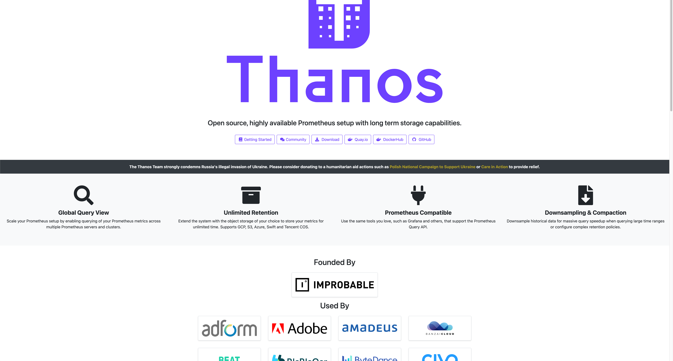
Thank you for being here.
https://xoap.io
© 2022 xoap.io all rights reserved

Slide 14
A few other ones …
Jerkie
Pilgrim
jsartJS
logeslow
https://mrsharpoblunto.github.io/foswig.js/
or
npm install project-name-generator –save
https://github.com/aceakash/project-name-generator
Thank you for being here.
https://xoap.io
© 2022 xoap.io all rights reserved

Slide 15
MySQL
RabbitMQ
HELM
Azure Pipelines
GitHub Actions
Prometheus
Open Policy Agent
Grafana
Grafana Loki
Fluentd
Vault
Keycloak
Kics
Terraform
AWS
Azure
and a lot more ...

Slide 16
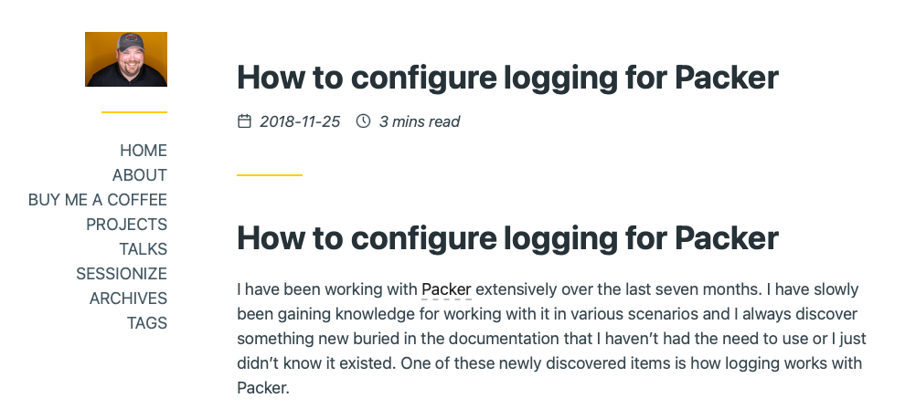
Thank you for being here.
https://xoap.io
© 2022 xoap.io all rights reserved

Slide 17
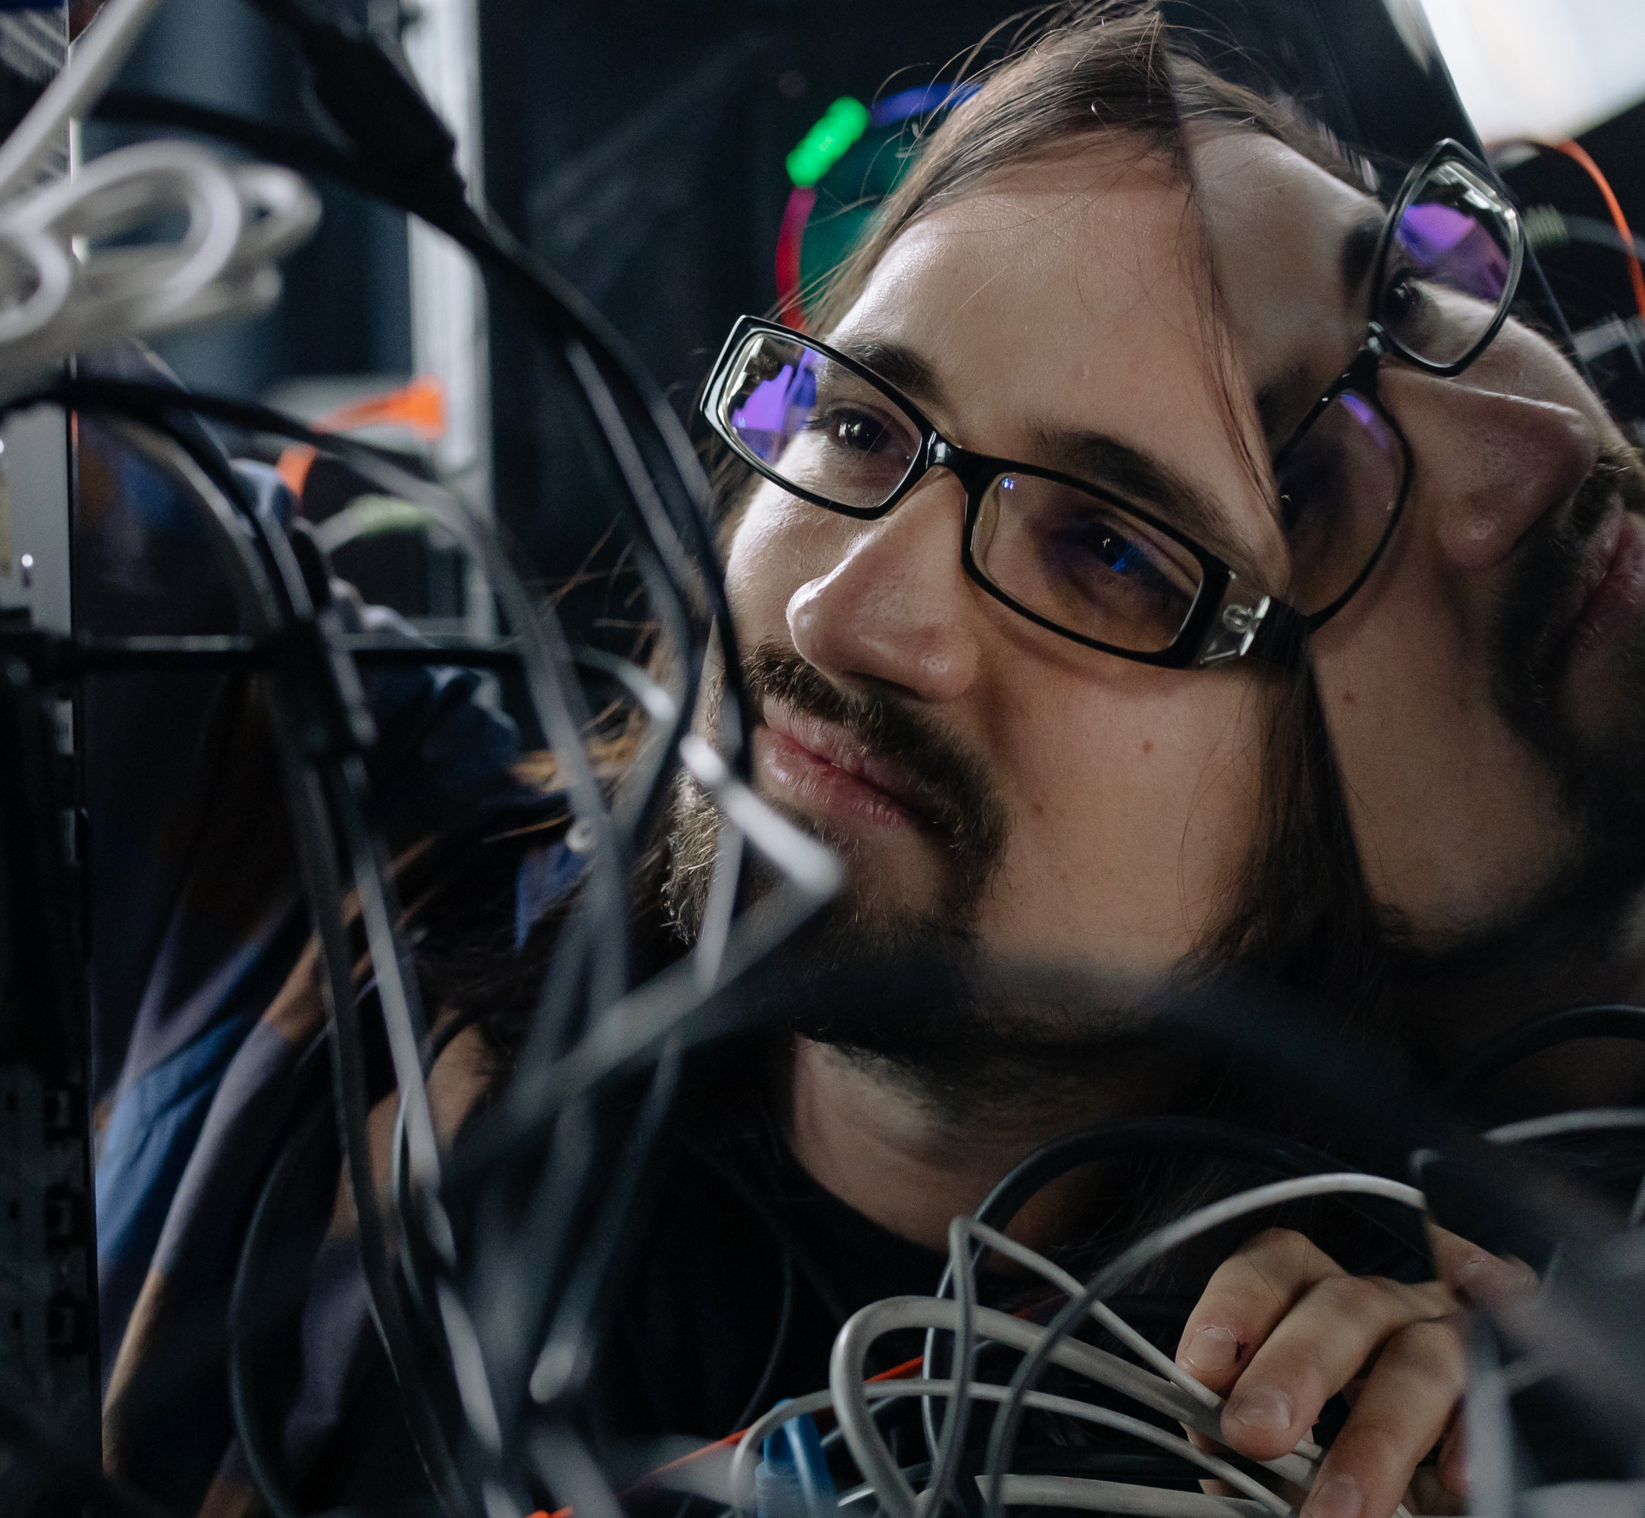

Congratulations! You are now a software developer…
Thank you for being here.
https://xoap.io
© 2022 xoap.io all rights reserved

Slide 18
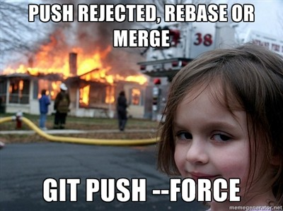
Developer live - you will MUST …
Use git and agile project management methodologies
Manage devops pipelines
Resolve merge conflicts
Resolve production deployment failures because somebody did:
git push –-force origin/master
Resolve production errors because a colleague did manual changes
Really check the pull requests, not only approve them
Start to think about branching strategies
Update and maintain all dependencies
Get used to IDEs (VSCode or IntelliJ)
Really start reading the documentation
Change the way you work completely
Thank you for being here.
https://xoap.io
© 2022 xoap.io all rights reserved

Slide 19
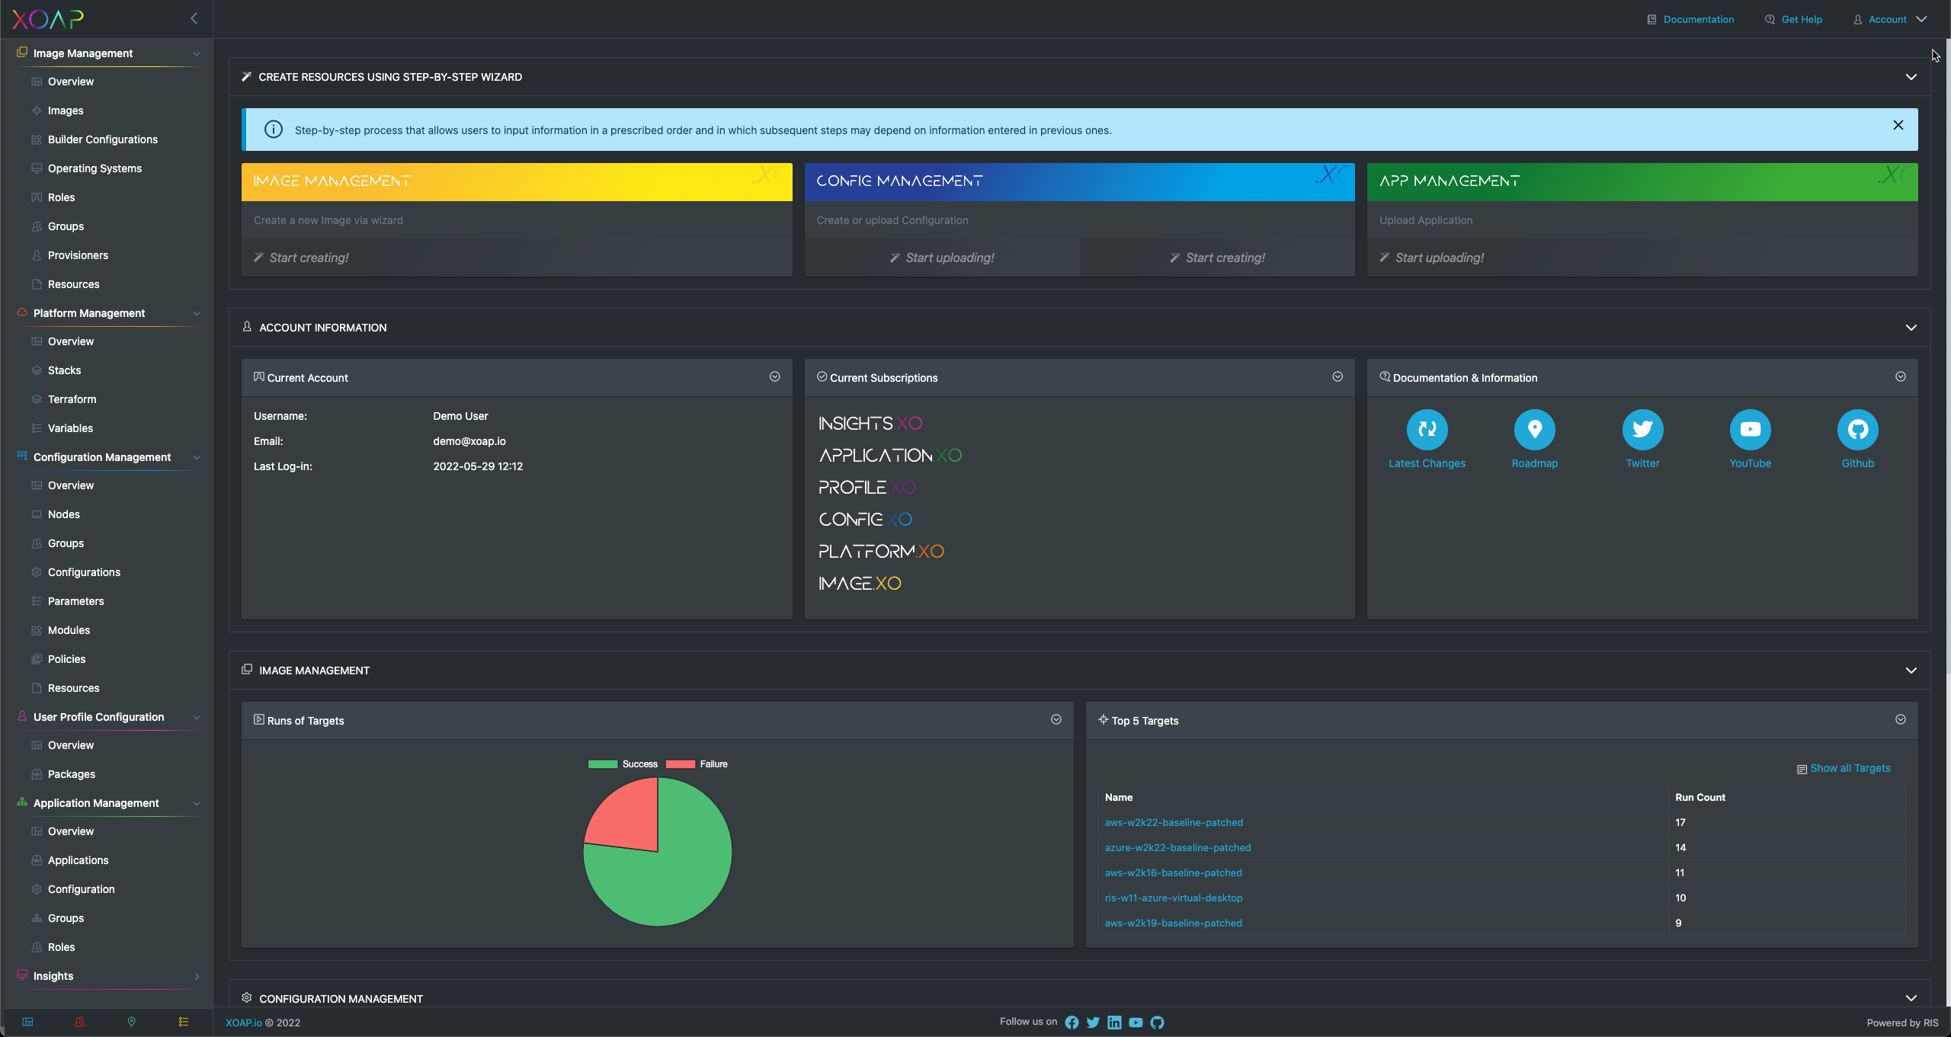
BUT there is hope
One SaaS console to rule them all
Code abstraction
Supports beginners and advanced use-cases
Simple to use wizards
Multi-Cloud support
Modular approach
Extendable
Developed in Germany
Trusted by Finance and Government
Thank you for being here.
https://xoap.io
© 2022 xoap.io all rights reserved

Slide 20

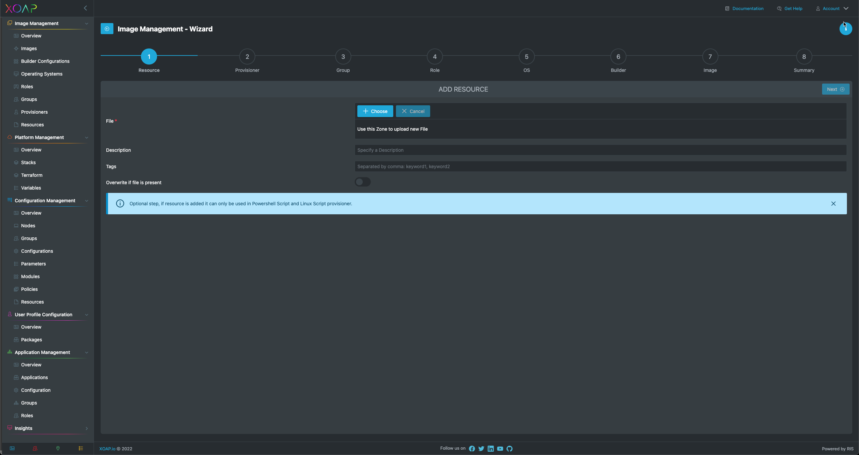
Based on Packer
Role Management
Group Management
Resource Management
Resource Editing
PowerShell DSC Provisioner
PSADT Provisioner
Image Wizard
Thank you for being here.

Slide 21

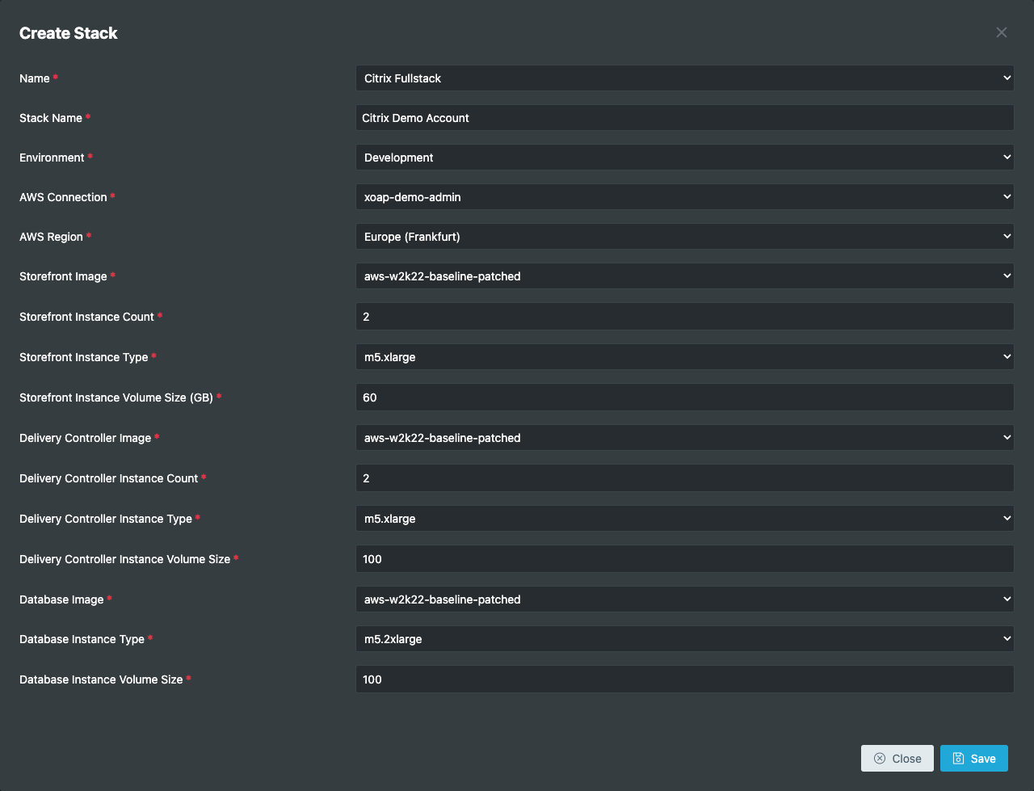
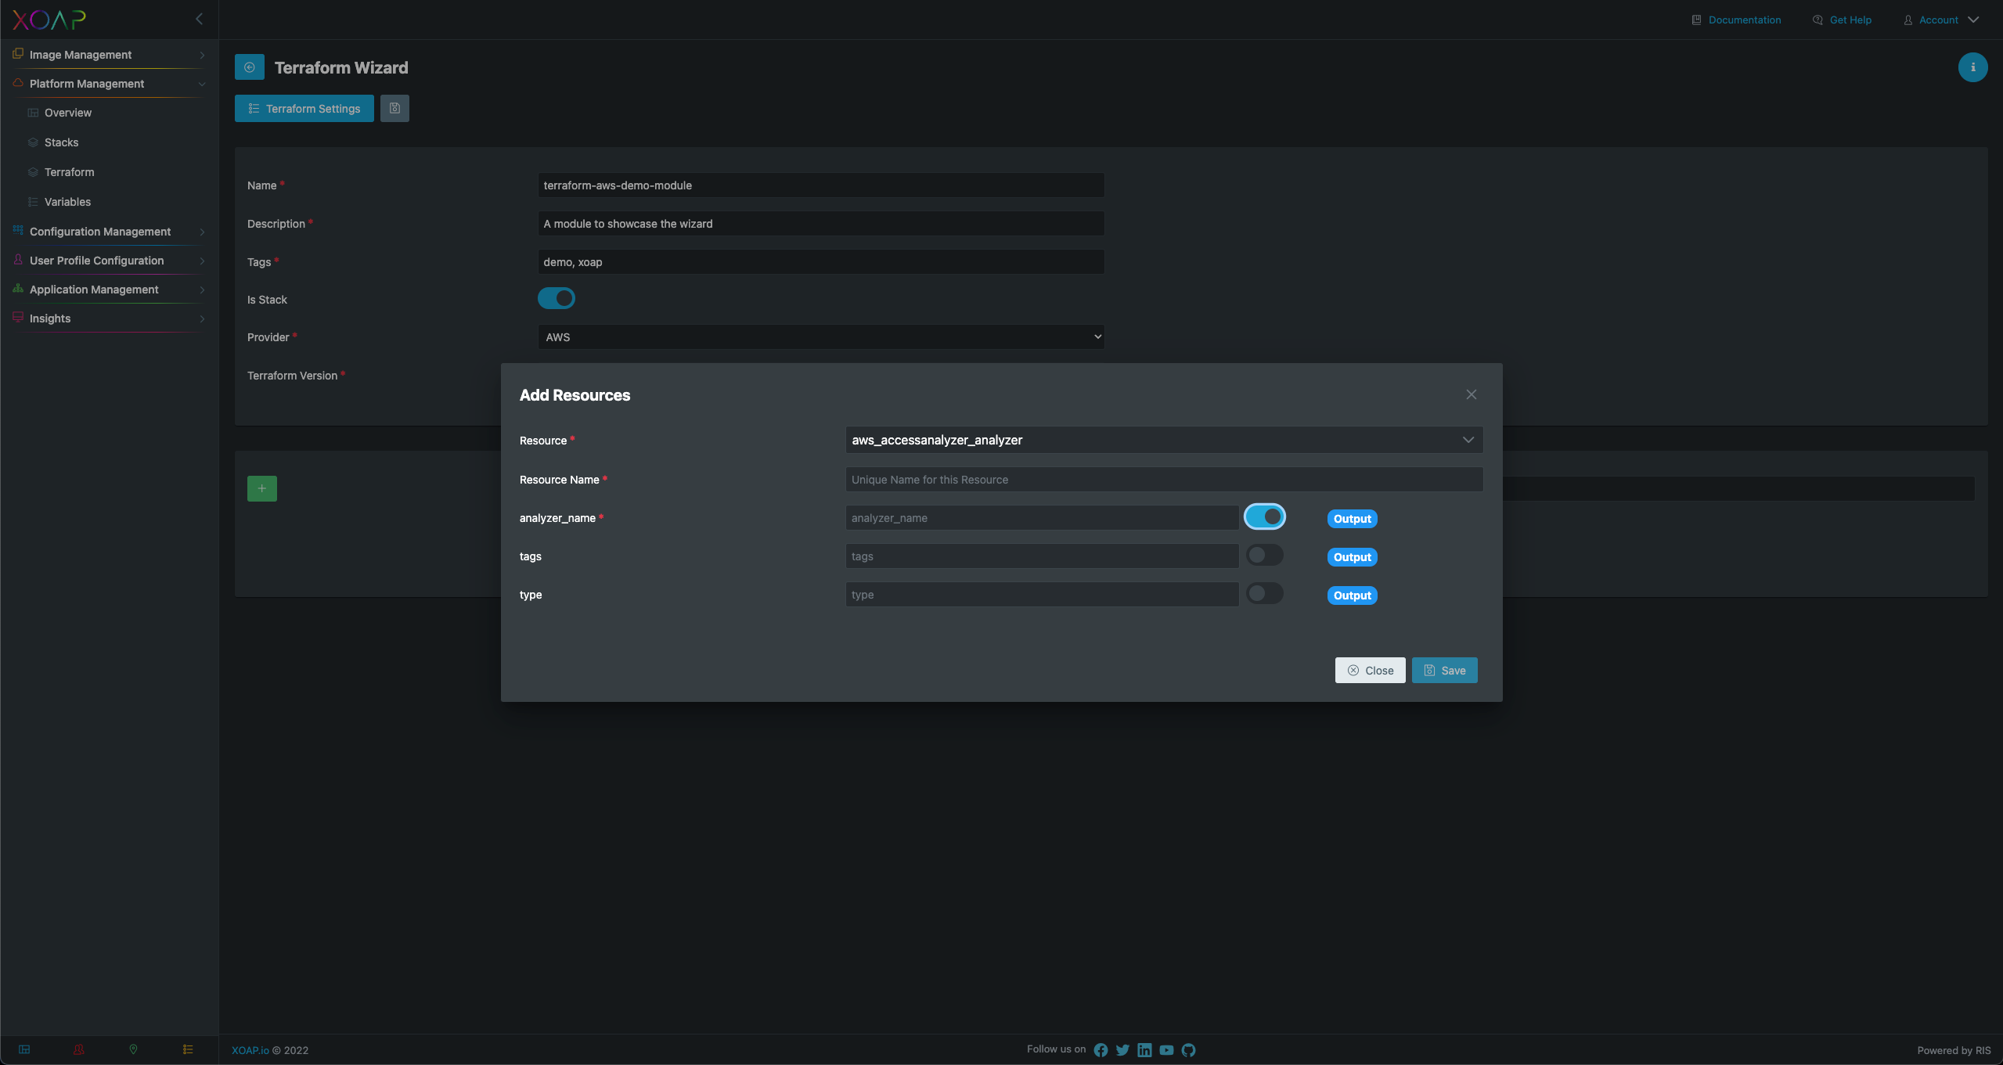
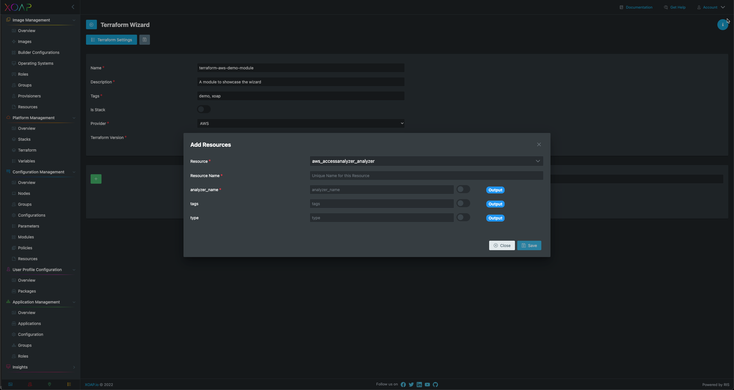
Based on Terraform
Stack Management
Module Management
Variables Management
Resource Editing
Platform Wizard
XOAP Modules
Thank you for being here.

Slide 22

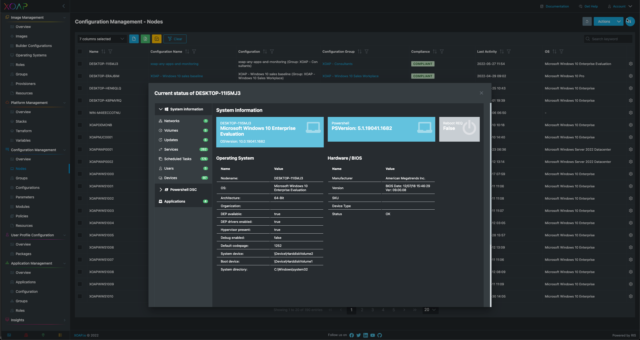
Based on PowerShell DSC
Node Management
Configuration Management
Module Management
Variables Management
Resources Management
Configuration Wizard
XOAP Modules
Thank you for being here.
https://xoap.io
© 2022 xoap.io all rights reserved

Slide 23

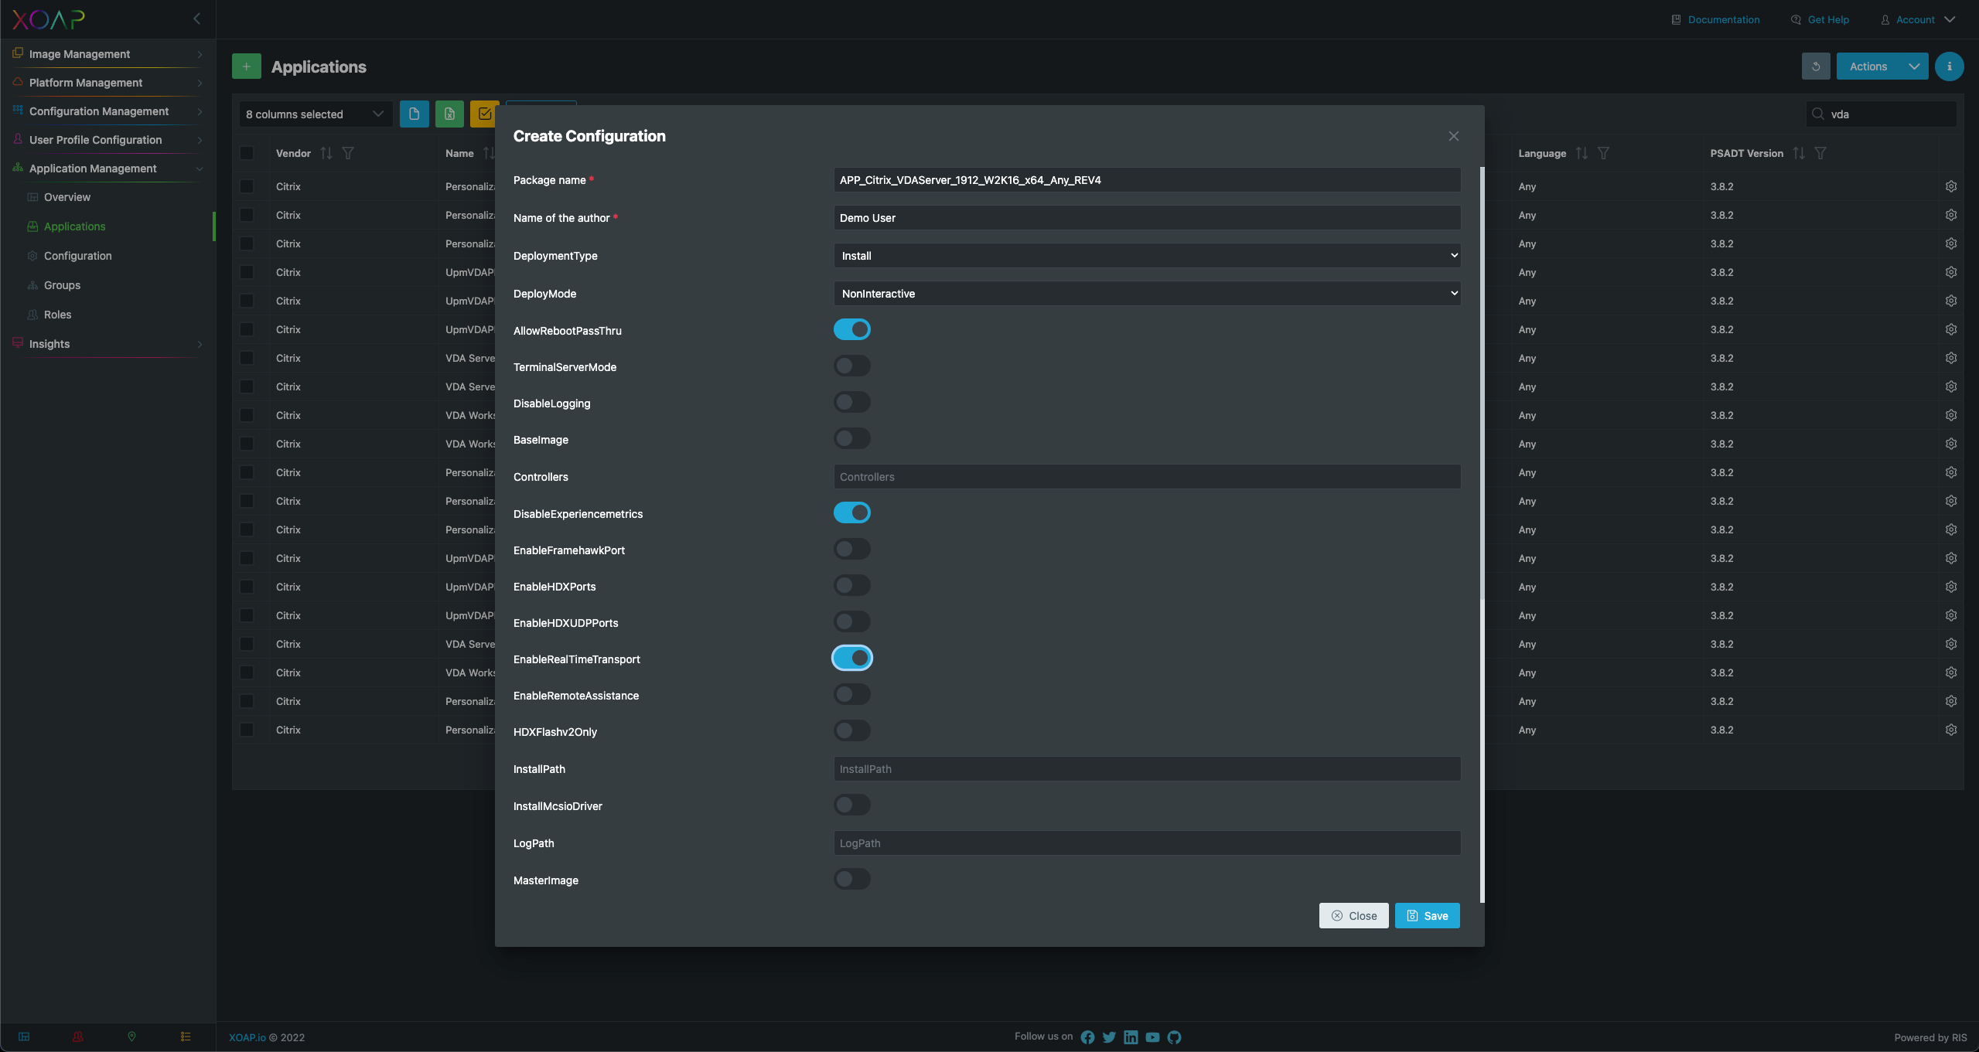
PSADT
GUI Configuration
Group Management
Role Management
Thank you for being here.
https://xoap.io
© 2022 xoap.io all rights reserved

Slide 24

Always latest PSADT packages
PowerShell DSC Modules
DSC Configurations
Image Templates
Dashboards
Thank you for being here.
https://xoap.io
© 2022 xoap.io all rights reserved

Slide 25
Community Session
The IaC Deployment Toolchain
Sat - 10:50
Masterclass
How to Build an Enterprise IaC Pipeline
Sat - 14:00
With drinks, lollipops and more merch!
Thank you for being here.
https://xoap.io
© 2022 xoap.io all rights reserved

Slide 26


We invite you for a try!
hello@xoap.io
xoap_io
https://www.linkedin.com/company/xoap_io
Thank you for being here.
https://xoap.io
© 2022 xoap.io all rights reserved

